Slide 1
Maths – One Voice
By Sara Lomas and Mark ives

Slide 2
How is learning across school sequenced?
EYFS: Curriculum
EYFS Guidance states:
Developing a strong grounding in number is essential so that all children develop the necessary building blocks to excel mathematically.
Children should be able to count confidently, develop a deep understanding of the numbers to 10, the relationships between them and the patterns within those numbers.
By providing frequent and varied opportunities to build and apply this understanding - such as using manipulatives, including small pebbles and tens frames for organising counting - children will develop a secure base of knowledge and vocabulary from which mastery of mathematics is built.
In addition, it is important that the curriculum includes rich opportunities for children to develop their spatial reasoning skills across all areas of mathematics including shape, space and measures.
It is important that children develop positive attitudes and interests in mathematics, look for patterns and relationships, spot connections, ‘have a go’, talk to adults and peers about what they notice and not be afraid to make mistakes.

Slide 3
How is learning across school sequenced?
EYFS: Curriculum (Reception)
ELG: Number
Children at the expected level of development will:
Have a deep understanding of number to 10, including the composition of each number;
Subitise (recognise quantities without counting) up to 5;
Automatically recall number bonds up to 5 (including subtraction facts) and some number bonds to 10, including double facts.
ELG: Numerical Patterns
Children at the expected level of development will:
Verbally count beyond 20, recognising the pattern of the counting system;
Compare quantities up to 10 in different contexts, recognising when one quantity is greater than, less than or the same as the other quantity;
Explore and represent patterns within numbers up to 10.
Celebration of maths and number in the discovery areas. Leading towards maths books.
Progression: numbers to 10 > deep understanding of numbers > patterns of the counting system > number bonds

Slide 4
How is learning across school sequenced?
Key Stage 1 and 2: Curriculum
The national curriculum for mathematics aims to ensure that all pupils:
become fluent in the fundamentals of mathematics, including through varied and frequent practice with increasingly complex problems over time, so that pupils develop conceptual understanding and the ability to recall and apply knowledge rapidly and accurately.
reason mathematically by following a line of enquiry, conjecturing relationships and generalisations, and developing an argument, justification or proof using mathematical language.
can solve problems by applying their mathematics to a variety of routine and nonroutine problems with increasing sophistication, including breaking down problems into a series of simpler steps and persevering in seeking solutions.

Slide 5
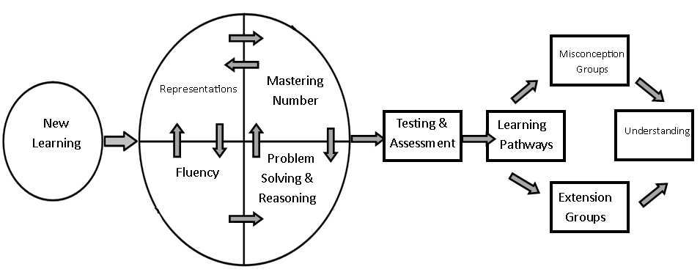
How is learning across school sequenced?
Maths Learning Cycle in KS1
NC objectives are taught within each year group and worked within our learning cycle for each unit of work.

Slide 6
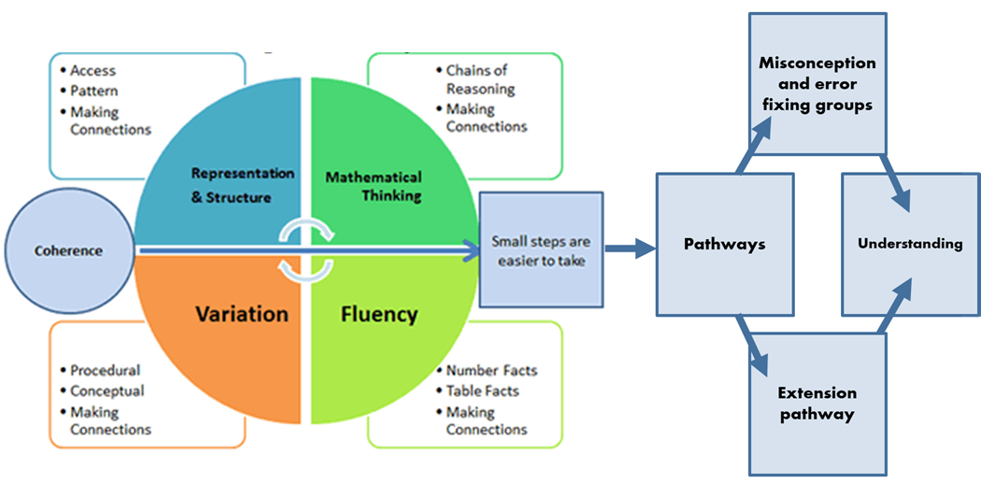
How is learning across school sequenced?
Maths Learning Cycle – KS2
NC objectives are taught within each year group and worked within our learning cycle for each unit of work.

Slide 7
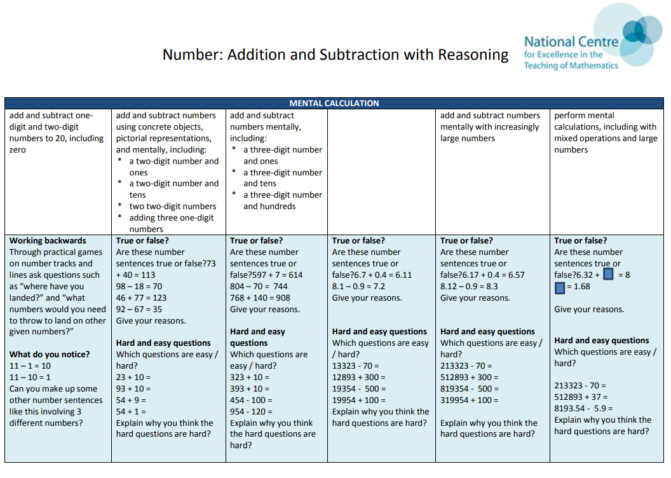
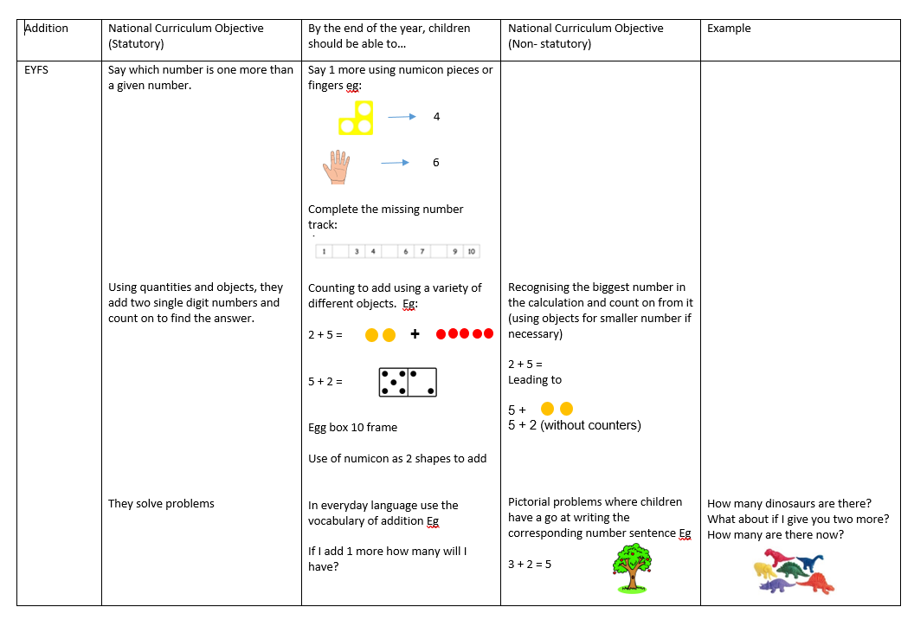
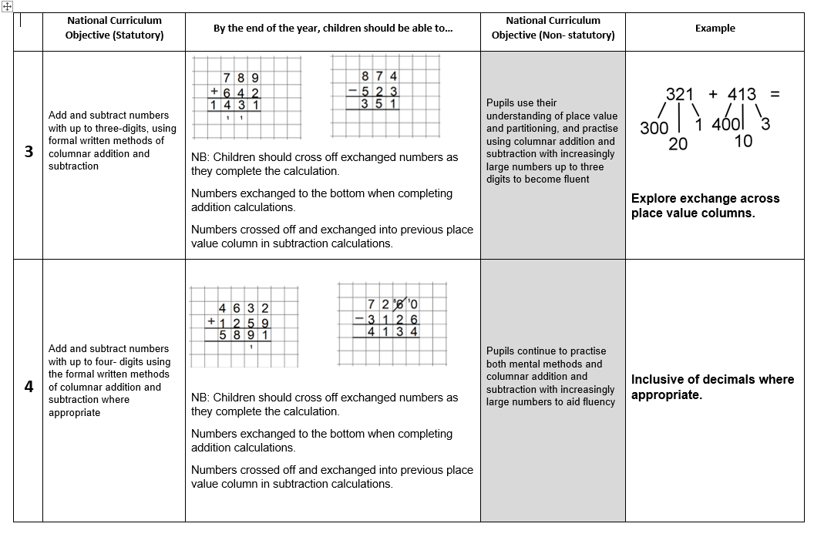
How is learning across school sequenced?
Progression of Skills Documents
Progression of skills documents from the NCETM and BHPS Calculation Policies are used to guide staff to know prior learning of the children and the next steps. This informs teachers planning accordingly.

Slide 8
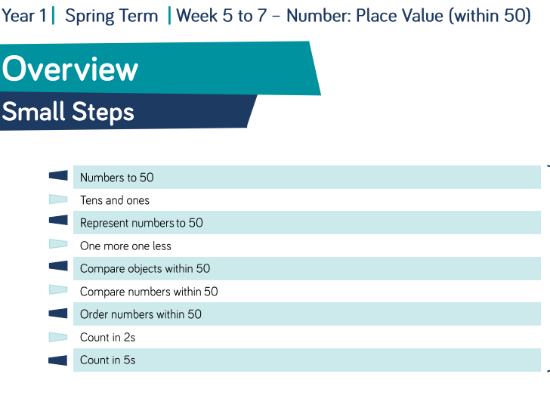
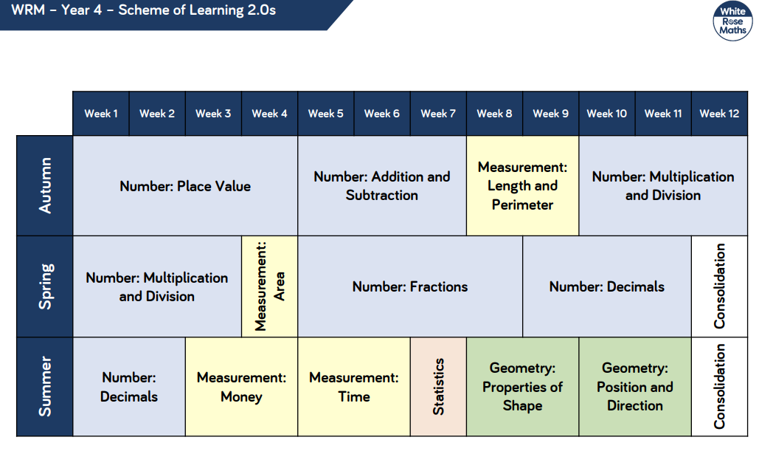
How is learning across school sequenced?
Long-term plans are constructed and built upon by each year group team.
These include:
key objectives taught from the National Curriculum
White Rose Maths LTPs and MTPs used by all staff from EYFS – KS2
NCETM Resources used throughout school.
NCETM Mastering number used in Yr R – Yr 2

Slide 9
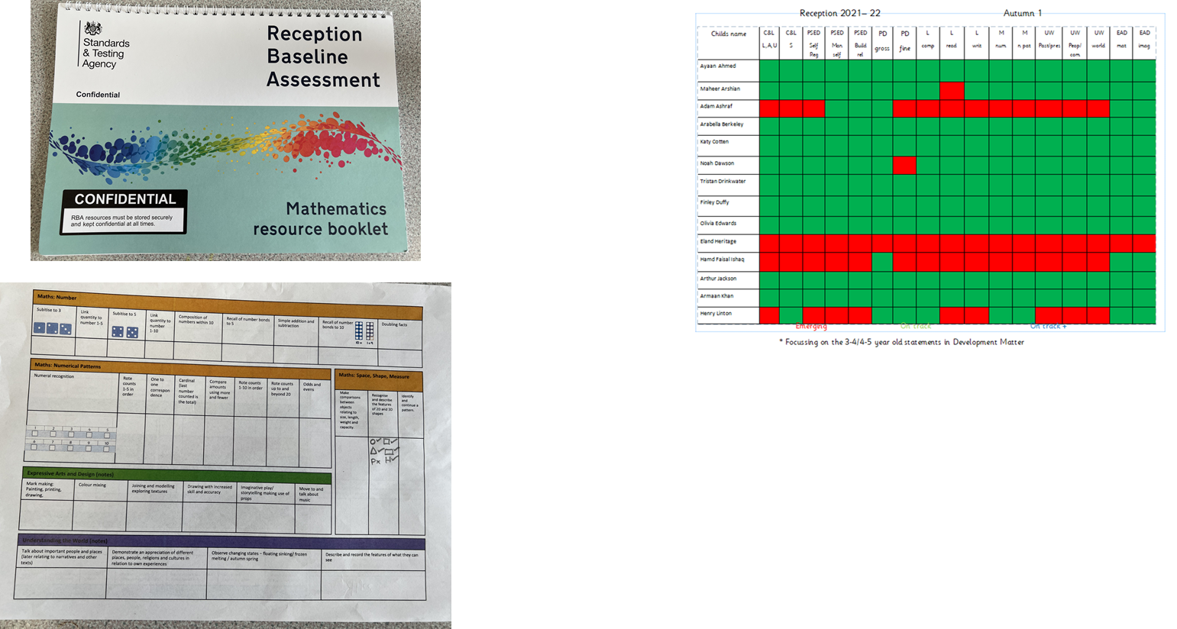
Measuring and Tracking Progress in the EYFS
Reception Baseline Assessment
Reception Tracker Grid
All children upon entry to BHPS complete a Baseline Assessment. This data is stored by the government and used by Yr R Teachers to assess prior knowledge before entry to school.
Children are then assessed throughout EYFS according to ELG and Development Matters documents to guide next steps of learning.

Slide 10
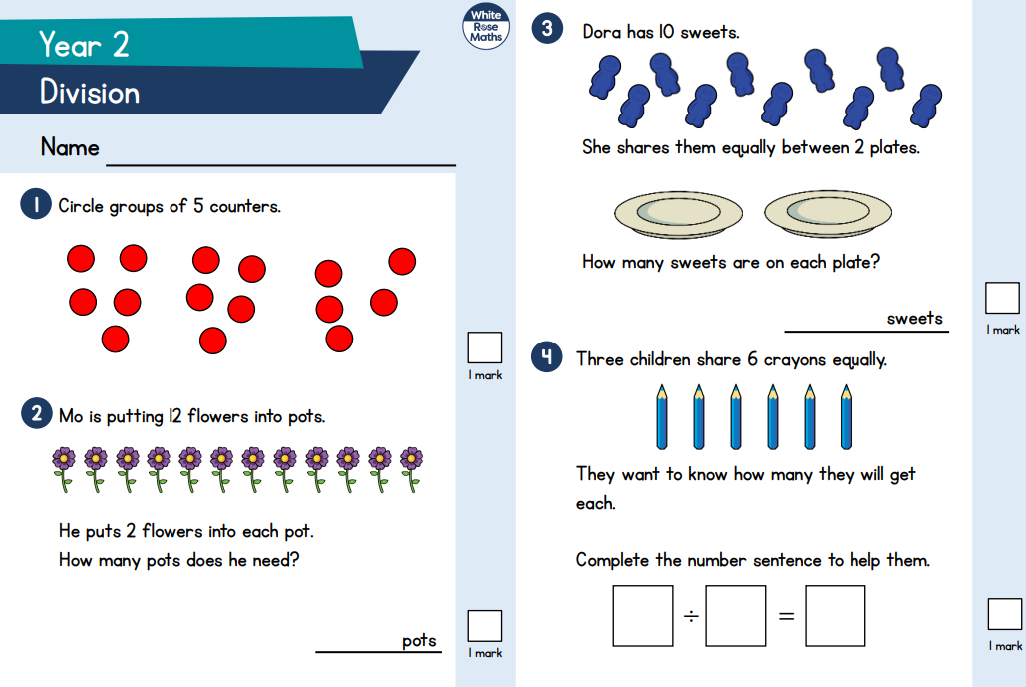
Measuring and Tracking Progress
End of Unit WRM Tests & Puma Tests used in KS1
Termly Puma Tests in KS2
Children’s termly data from Year 2-6 are used and tracked on SIMs and are the basis of discussions with Pupil Progress meetings to monitor and track a child’s progress related to ARE.

Slide 11
Priority 1: Implement and Embed NCETM Mastering Number in EYFS & KS1 .
Focus of the programme
Aims to secure firm foundations in the development of good number sense for all children from Reception through to Year 1 and Year 2.
The aim over time is that children will leave KS1 with fluency in calculation and a confidence and flexibility with number.
Attention will be given to key knowledge and understanding needed in Reception classes, and progression through KS1 to support success in the future.
Training delivered by the NCETM has been attended by all year group leads, with both teachers attending where possible. Further termly training will be held to ensure the objectives are covered according to the guidance. SL has been in regular discussion with EYFS, Year 1 & 2 teachers to check progress and relevance of the programme and seen evidence of the children’s learning.

Slide 12
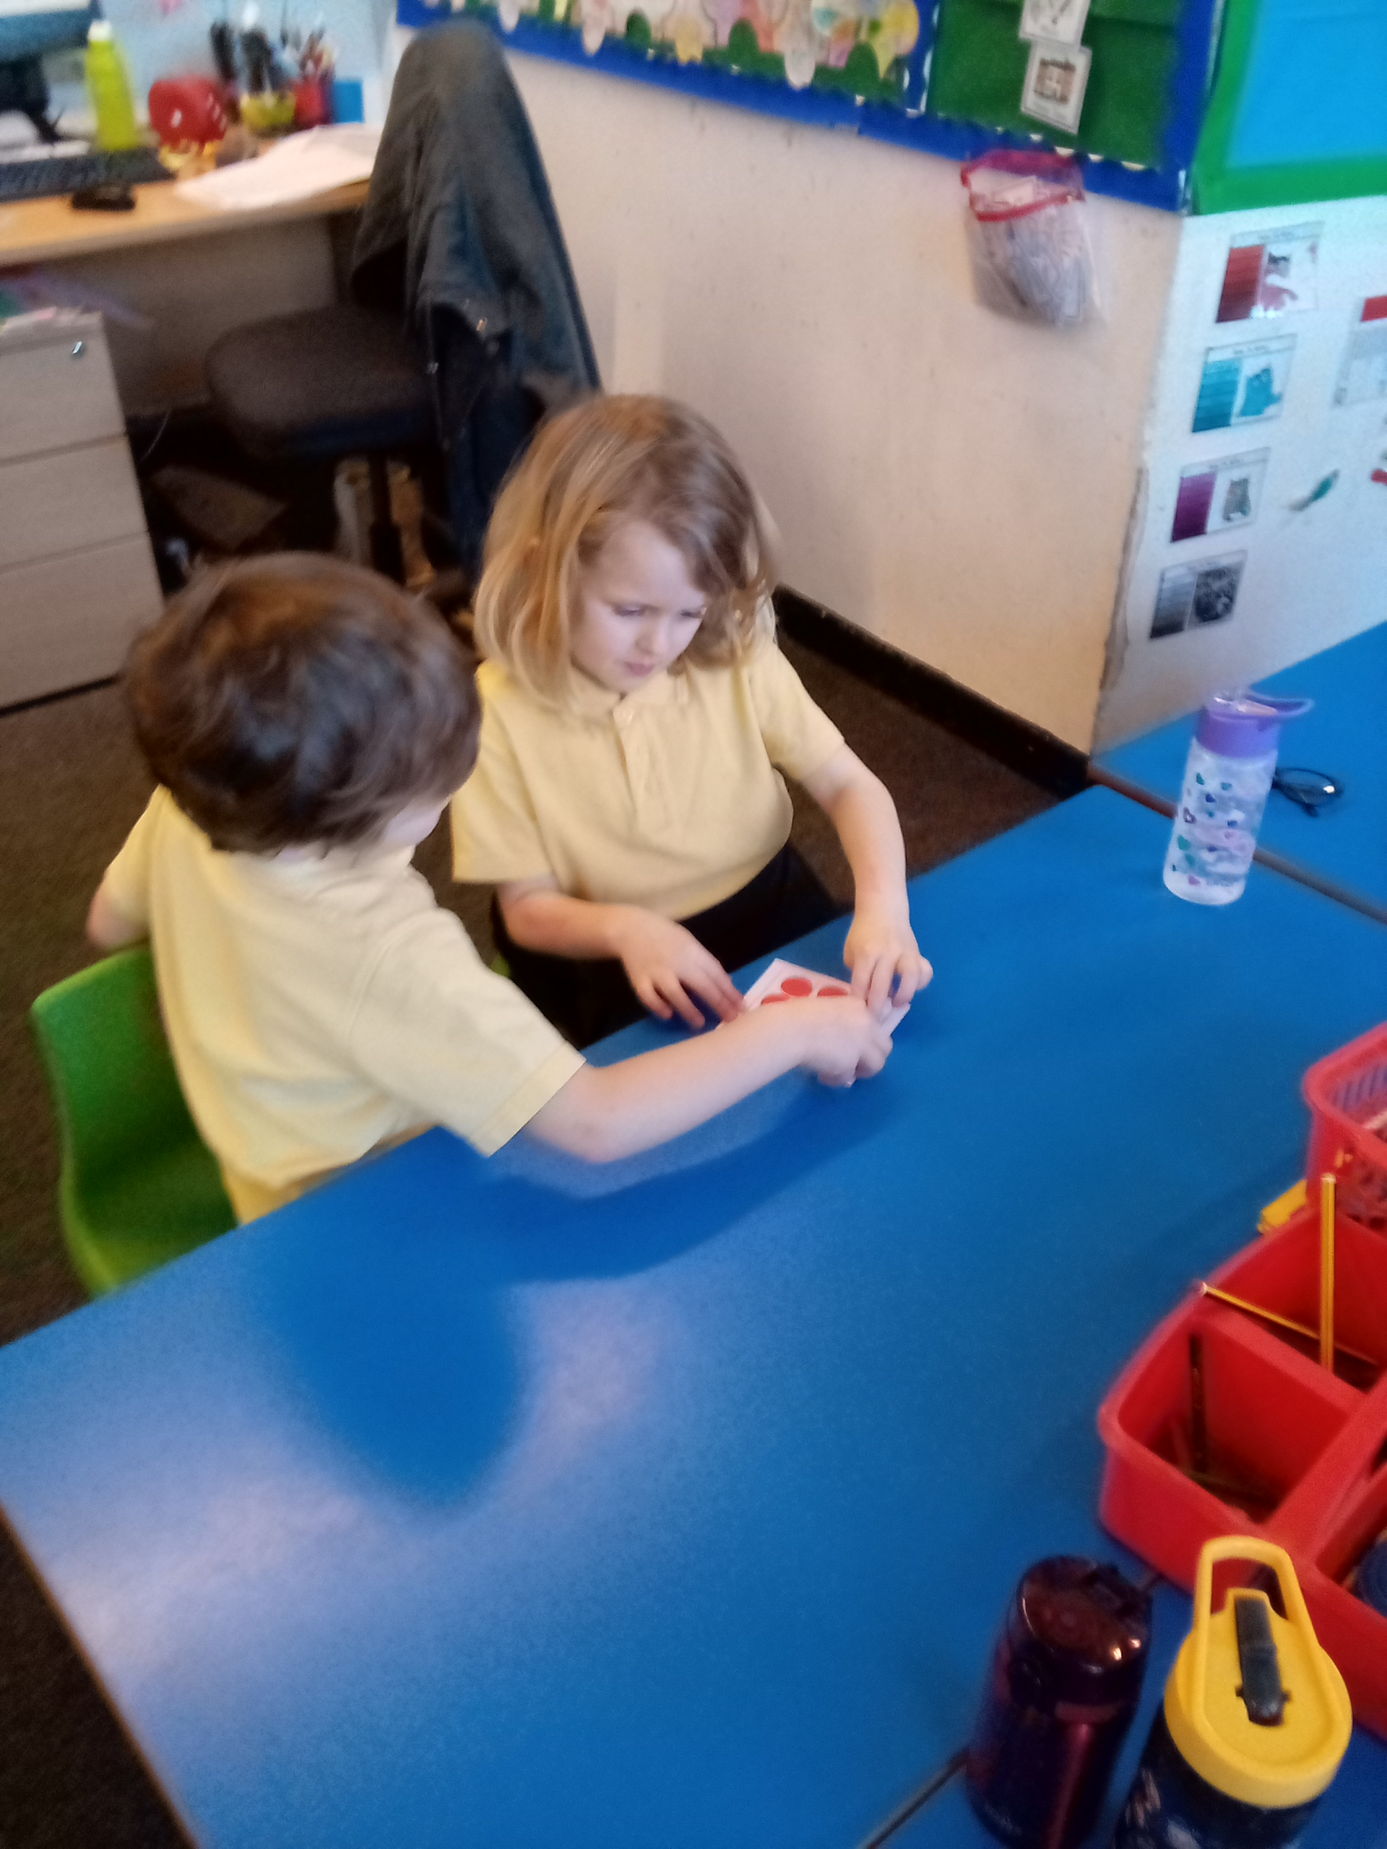
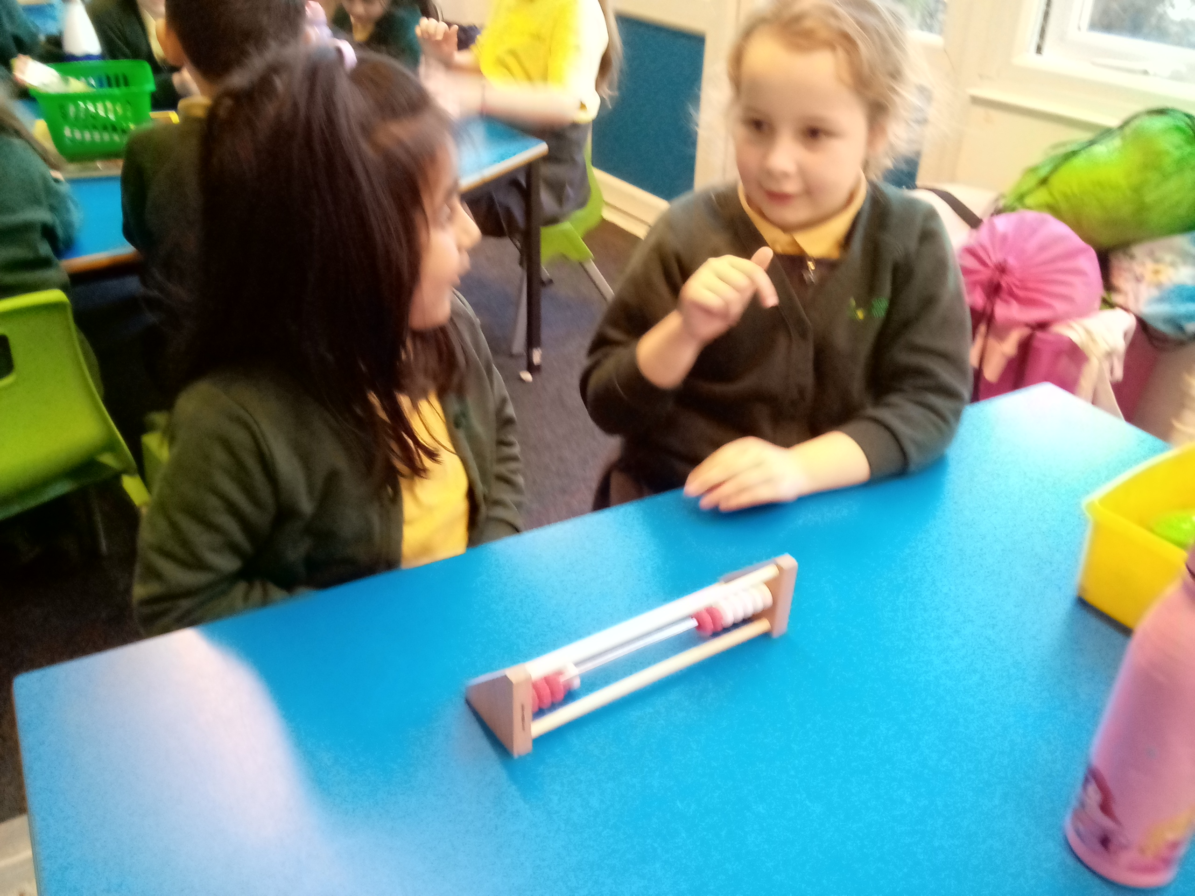
Priority 1. examples

Slide 13
Priority 2 – I do, we do, you do teaching.

Slide 14
Priority 2. examples

Slide 15
Measuring and Tracking Progress
Data inputted on SIMS on a termly basis

Slide 16
Measuring and Tracking Progress Data

Slide 17
Priority 3 – Based on data evidence.

Slide 18
Monitoring:
Learning Walk carried out in KS2
Learning Walk carried out in KS1
Book Flick in Autumn
Data monitored from Pupil Progress meetings in Spring term
Marking Policy Check in Autumn
Long Term plans checked against work in books in Autumn

Slide 19
Strengths:
Learning Cycle: Clear opportunities for children to make and see their progress
Raising the profile of Mastering Number: Clear expectations and guidance for teachers
Assessment: Clear expectations for data input (Teacher assessment and Puma data) on a termly basis
Marking Policy: Clear and adapted for KS1 and KS2

Slide 20
Next steps:
Continue 2022 Monitoring: Pupil voice and lesson observations

Slide 21
Thank you for your time.
Do you have any questions?

