Slide 1
Science – One Voice
By Grace Codling (KS2) and Sophie Felstead (EYFS and KS1)

Slide 2
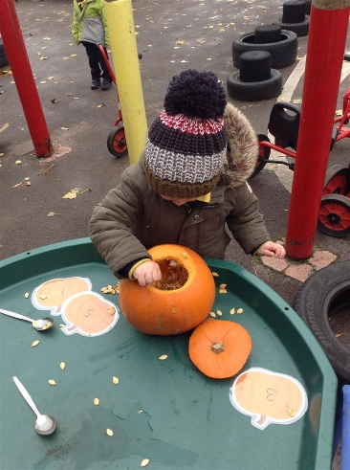
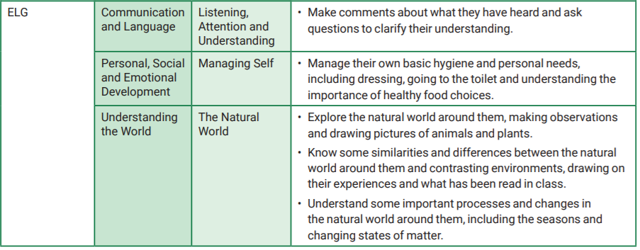
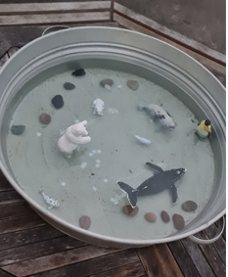
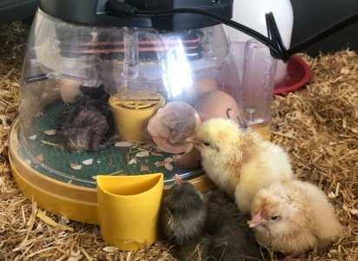
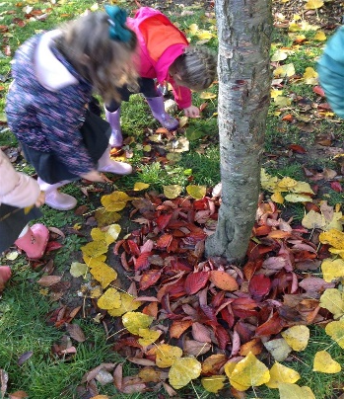
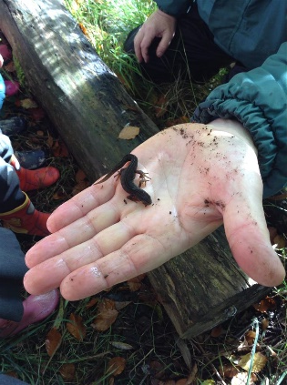
How is learning across school sequenced?
EYFS and Science

Slide 3
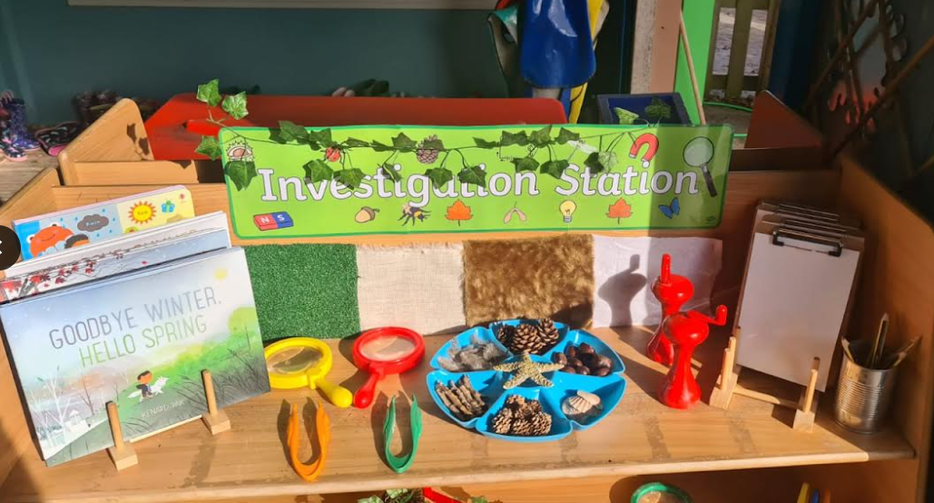
Investigation Station
Includes torches, magnifying glasses, Science books, clip boards.
Allows children to take control and have ownership over what they are interested in or would like to investigate. For example; children often find things in the outdoor environment that they want to investigate such as; pinecones, feathers and conkers.

Slide 4
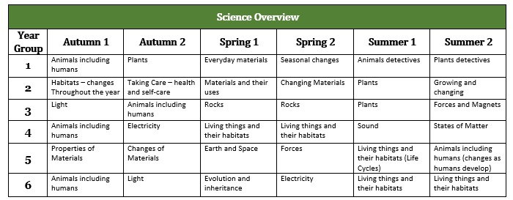
How is learning across school sequenced?
Learning is sequenced based on suitability with wider curriculum and seasonal suitability. For example: Year 5 Earth and Space coincides with Ancient Maya History topic to link with Astronomy. Year 1 complete Plants unit in the Autumn to coincide with seasonal changes.

Slide 5
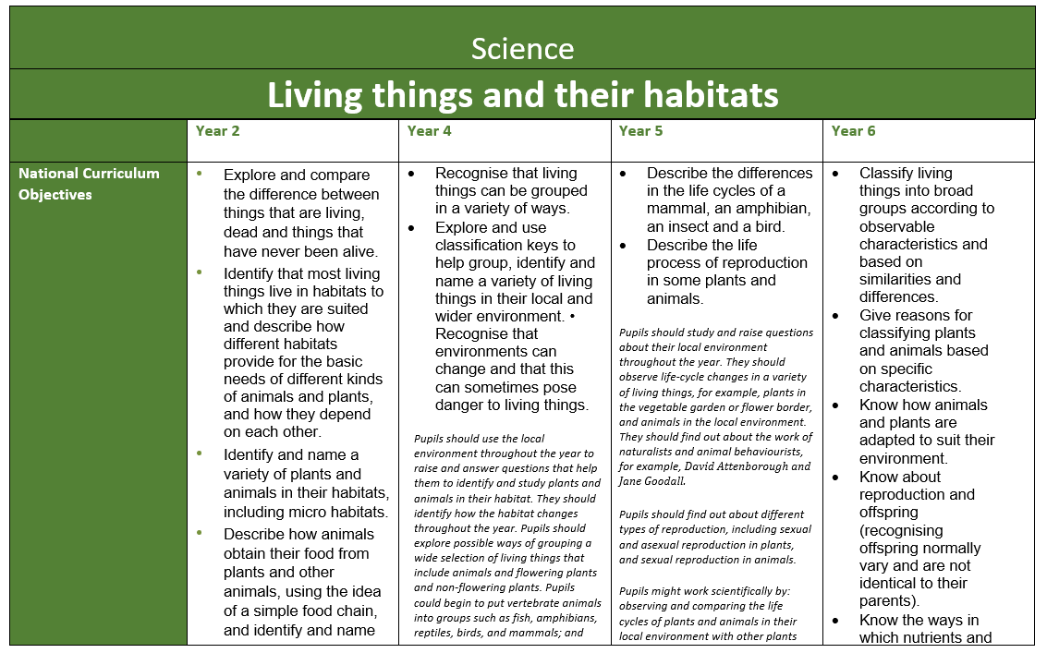
How are knowledge and skills built upon through the school?
Clear progression documents for each topic to outline how each topic is built upon in each year group.
Teachers have a clear understanding of what has been covered in previous year groups (recorded on topic cover sheets)
Children are able to see what they have previously covered in their topic cover sheets.

Slide 6
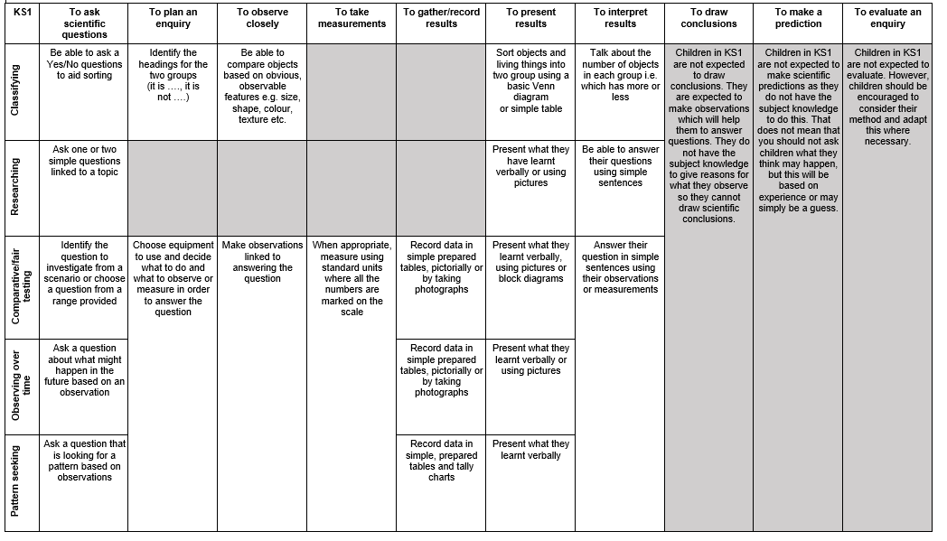
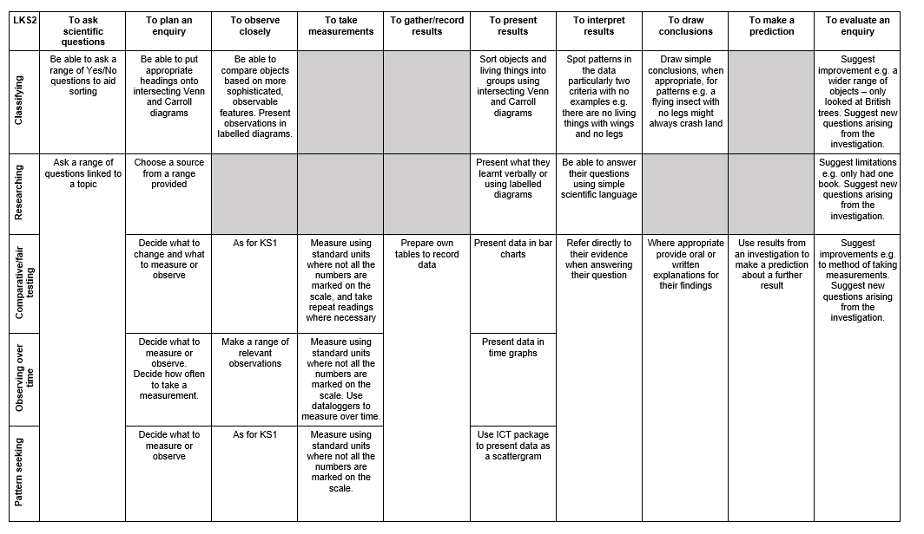
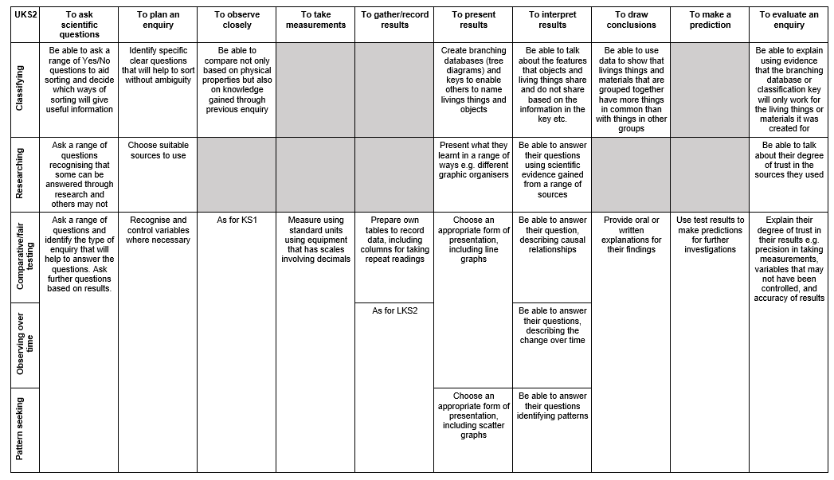
How are knowledge and skills built upon through the school?
Clear progression documents for the working scientifically skills for KS1, LKS2 and UKS2
Each enquiry type has activities which can be progressed across key stages

Slide 7
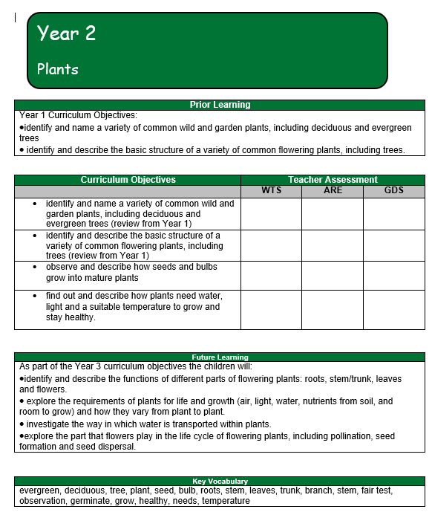
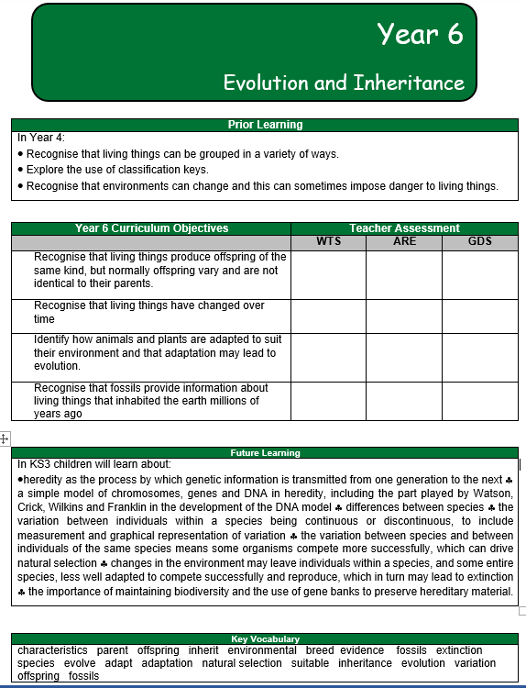
How are knowledge and skills built upon through the school?
Topic cover sheets used at the beginning of each unit and details prior and future learning so children and teachers have a clear view of their learning journey.

Slide 8
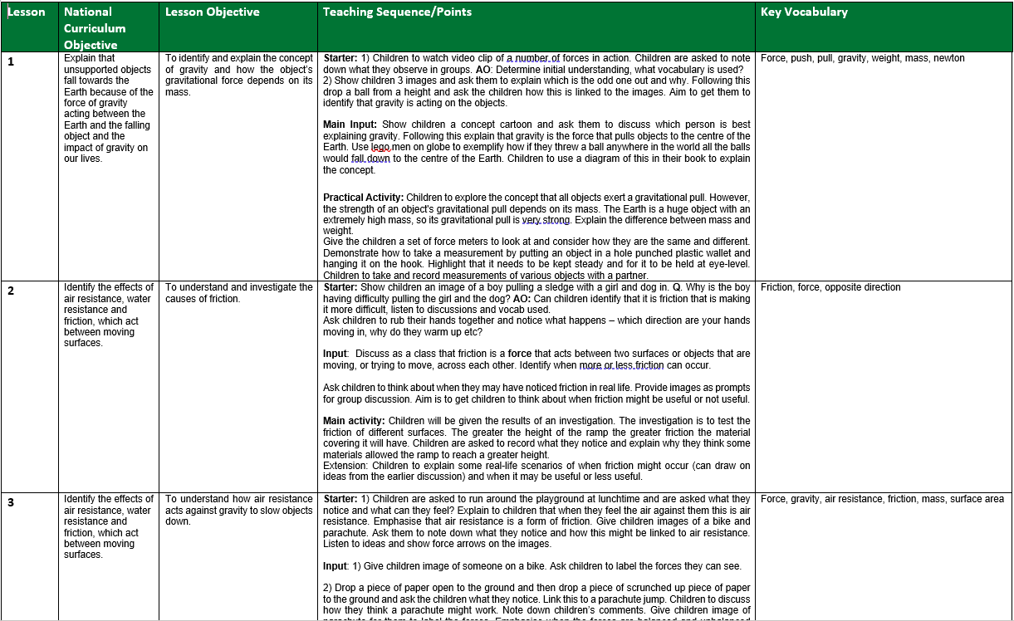
How are knowledge and skills built upon through the school?
Bespoke schemes of work are created for each individual topic – NC objectives are used to create six lessons.

Slide 9
Challenge and Differentiation:
Challenge:
Staff create bespoke schemes of work where time is taken to identify key opportunities for challenge.
Opportunities for deeper understanding are identified through an understanding of where learning is going in the future and application and reflection of key knowledge
Wider curriculum opportunities applied: Writing in up scientific reports in Y5 and 6, links to Literacy, Computing units.
SEND & EAL: Differentiation
Independent challenges are accessible and practical
Children can evidence their work through pictures/videos/ voice recordings that they have recorded independently.
Regular recapping of vocab using the Science working wall to revise and revisit.
Use of sentence stems and scaffolds for written work.
One to one or group support during introductions.
When the children are completing their work and independent challenges they have adult support or are put with an appropriate partner.

Slide 10
Linking learning and remembering learning:
Vocabulary and concepts recapped regularly: Use of working walls to refer to vocabulary and key concepts on a regular basis.
Assessment strategies: Concept maps, end of unit assessments, quizzes used to recap each unit.
Sticky learning: School visits, hands on investigations, DEAL strategies, active learning techniques
Revisiting and remembering more overtime: - Class discussions ‘last year, you learnt… and this year you’ll… before next year when you study…’. - Quizzes: High challenge and low threat.
KS1 – previously taught practical activities are then used as independent challenges in future lessons.

Slide 11
Science – Children’s books and outcomes:
Are there non-negotiables for the presentation of science and children’s expectations?
Cover sheets for each science unit containing prior learning, the unit’s learning objectives, future learning and key vocabulary.
Date and learning objective evident in children’s work
Presentation and outcomes consistent across year groups: Ensure both classes are presenting learning in the same format and with the same high expectations to challenge children and ensure high quality presentation.
Broad, rich and balanced science curriculum evident through children’s learning.
Rolling out of evidencing progression throughout lessons which is evidenced in books: Children start with an initial concept and question where they are able to evidence their knowledge and initial thoughts.
Vocabulary emphasis: children are using vocabulary within their written work and spoken in classroom discussions.
Planning grids for investigations are being rolled out across KS2

Slide 12
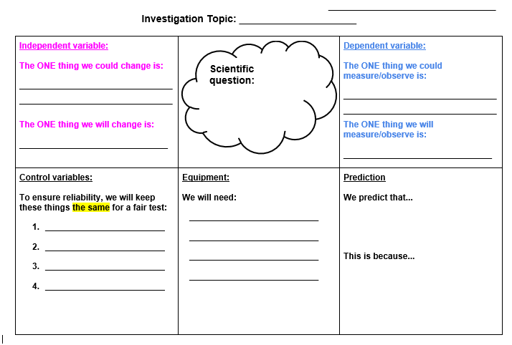
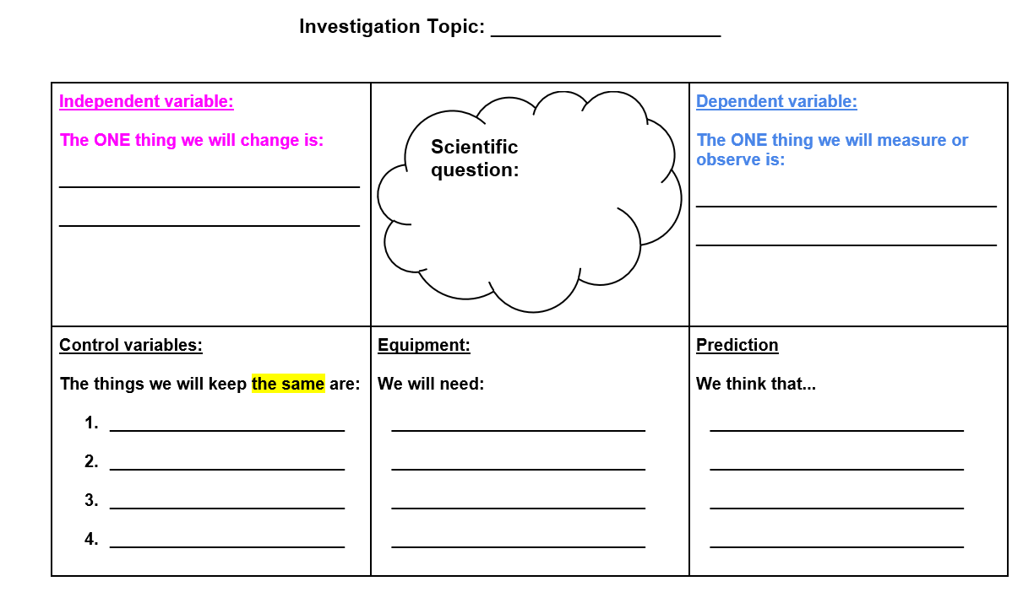
Science – Children’s books and outcomes:
Science investigation templates used in KS2.
Year 5 and 6
Year 3 and 4

Slide 13
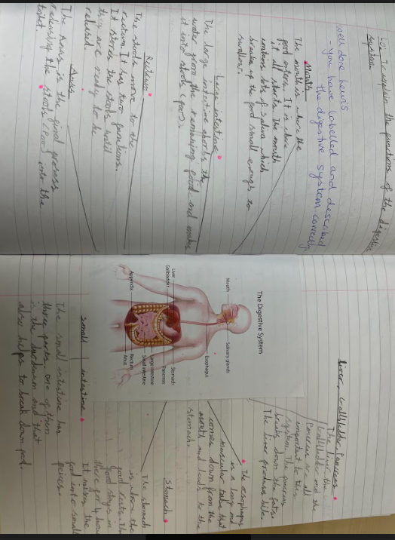
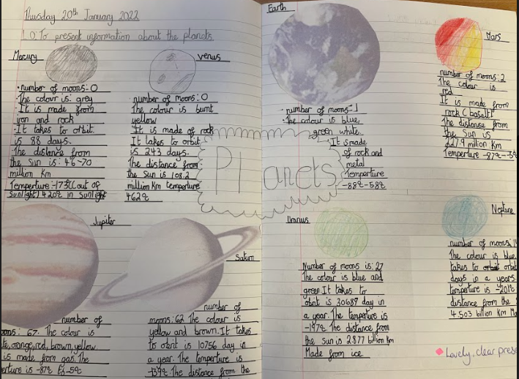
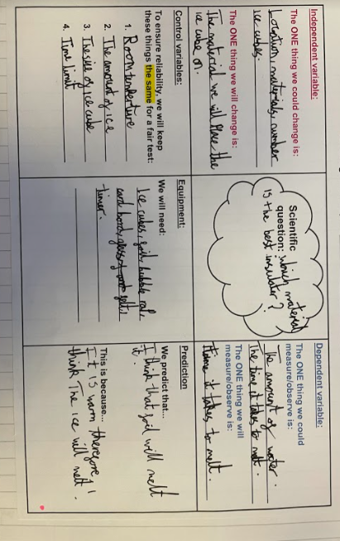
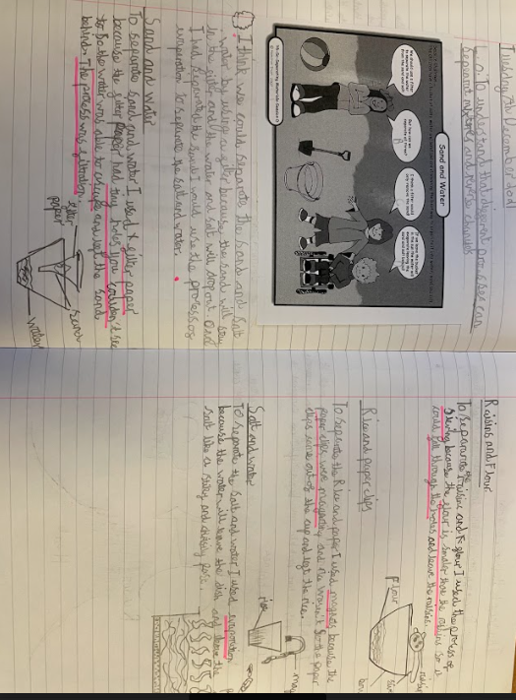
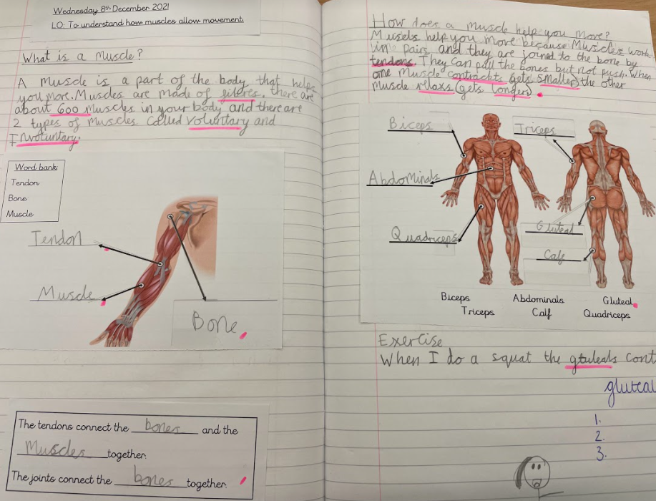
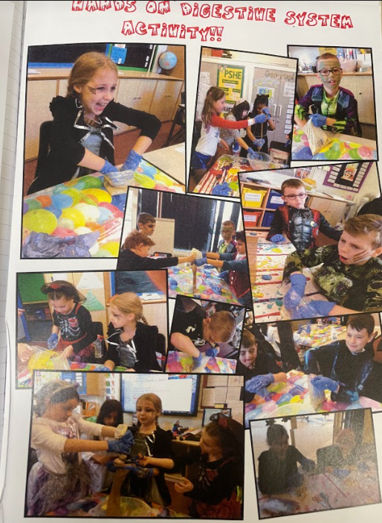
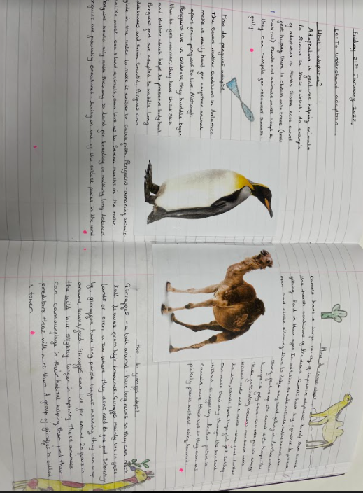
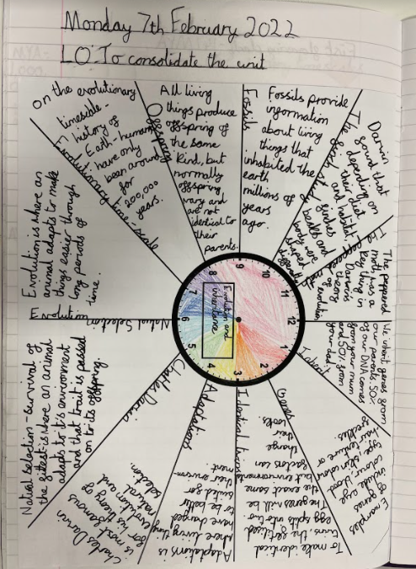
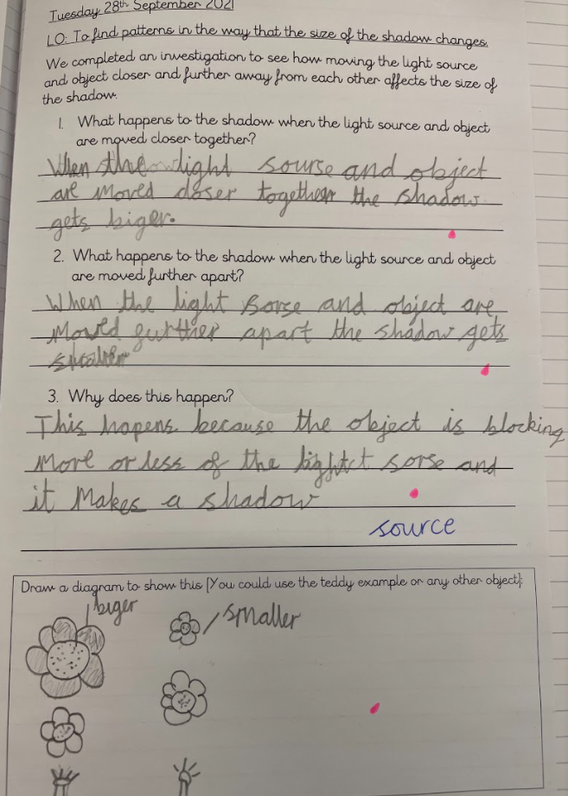
Year 4
Year 3
Year 6
Year 5

Slide 14
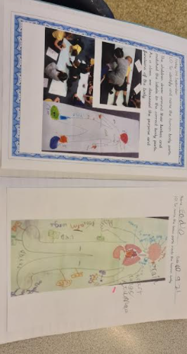
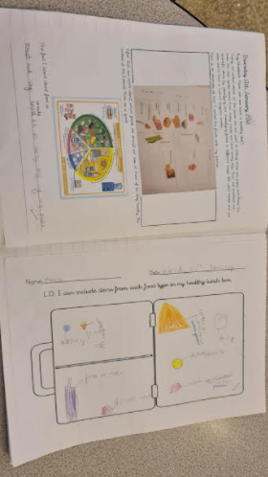
Year 2
Year 1

Slide 15
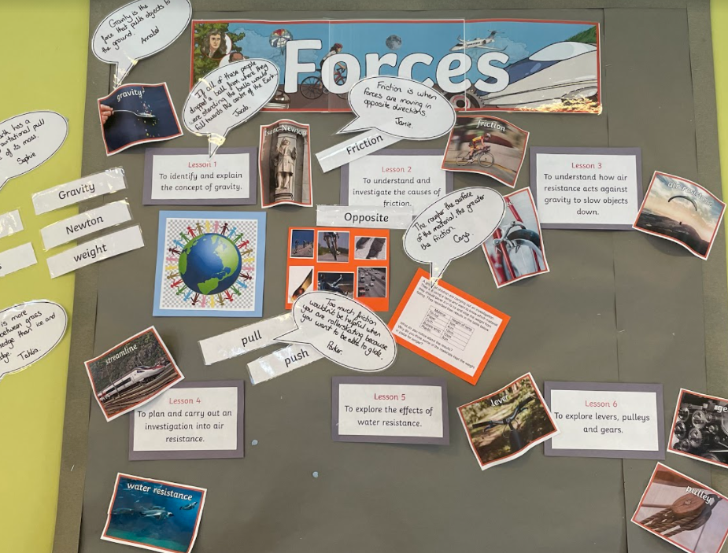
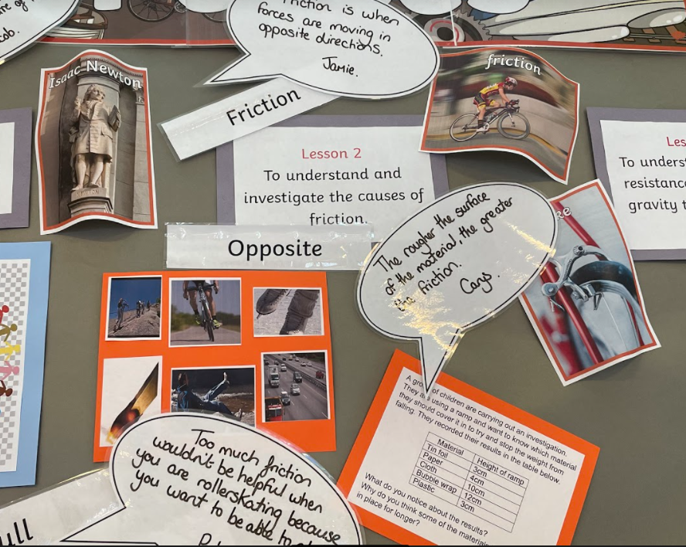
Science – Policy: Presentation and Working Walls
What should my Science working wall look like?
Topic title clearly evidenced
Learning objectives for each lesson should be present to demonstrate the learning journey
Comments from children
Vocabulary used for each lesson
Examples of resources used during the lesson – concept cartoons, images of practical investigations etc
Examples of children’s work from the lesson

Slide 16
Science – Book Flick and Pupil Voice Spring 1
Whole school book flick feedback
Cover sheets are consistently used throughout school to ensure staff have a clear understanding of pre and post learning and how it fits in with each year groups objectives.
Each year group is encouraging children to provide extended answers in their written work
Books throughout key stage clearly evidence progression and increase in expectations
Children are actively using key vocabulary
At the beginning of each lesson we are asked to revise vocabulary and learning from the previous lesson, we make connections through concept maps – Year 6
We use actions to remember key words.– Year 3
We begin lessons by identifying what we know and then review this at the end of the lesson to see if our knowledge or opinion has changed.
We always recap the vocabulary in each lesson – Year 5
Each lesson always starts with a recap of the previous lesson.– Year 4

Slide 17
Strengths:
Schemes of work: Clear coverage across each unit.
Progression for assessment: Vocabulary and objectives clear for staff to form judgements.
Bespoke and engaging lessons driven by a quality scheme of work and high-quality teaching and learning.
Regular subject monitoring to ensure open dialogue between subject leaders and class teachers.
Policy: Clear and outlined for staff – working walls, units, presentation of work.

Slide 18
Next steps:
2021 - 2022 Monitoring: Pupil voice, lessons and book flicks –Spring 1 & Summer 1
Outcomes in books: Consistency of approach through investigation templates, outcomes show progression of knowledge throughout lesson
Remembering more: Ensure children are regularly revising key concepts and vocabulary
Enquiry types: Identify approach for children and staff to record the enquiry and skills approaches being used in lessons.
Assessment procedure: set up but not had the time to be fully tested and provided with valuable data.
Opportunities for links with experts and universities to further enhance curriculum.

