Slide 1

Bradshaw Hall Primary School
Aims, Values and Superpowers.

Slide 2
BRADSHAW HALL SCHOOL AIMS
We are committed to delivering a curriculum which enables all our children to become responsible, resilient and successful learners. Acquiring powerful knowledge, skills and attitudes is at the heart of the curriculum intent. Our powerful curriculum is congruent with our School Aims, Values and Superpowers supporting high aspiration and a passion for lifelong learning, as well as encouraging curiosity, aspiration and a love of learning.
Our innovative and aspirational approach to the curriculum is constantly adapted to ensure the Bradshaw Hall aims and values are met. Our bespoke approach is uniquely designed to support children’s character. Consequently, children understand their role and purpose now and are prepared for their future role in society. Bradshaw Hall is committed to achieving this vision through:
• ensuring that all decisions made in school contribute toward our vision, aims and ‘Superpower’ characteristics.
• utilising research informed approaches to support high quality staff development
• a committed, engaged, reflective and high performing team.
• positively engaging with, and proactively encouraging change to fulfil our aims.
• teaching transferrable skills and personalising learning.
• engaging with the wider world more meaningfully and taking a ‘wider’, more holistic approach to curriculum provision.
• listening and communicating views between stakeholders.

Slide 3


Slide 4
Values of Responsible Citizens
Values of Resilient Learners
Bradshaw Hall Primary School encourages:
a love of learning, inspired by high quality teaching and thoughtful planning that is purposeful, collaborative and that motivates our children.
high expectation, challenge and the determination to achieve.
a range of opportunities, designed to develop every child’s sense of what is possible for them to achieve now and in their future lives.
opportunities and inspirational experiences so that children’s talents in many areas can be identified and developed.
links and networks beyond the school.
everyone to strive for excellence, where the staff are committed to their own learning journey and the sharing of quality practice.
parents to support and engage with their children’s learning.
Values of Successful Learners
Bradshaw Hall Primary enables everyone to achieve and be proud of their achievements through:
• a curriculum that ensures all children have the skills, knowledge, attitudes and character to achieve in all aspects of their lives.
• the development of character and learning, enabling children to become resilient and successful.
• high aspiration and expectation for every child and member of staff.
• a curriculum that promotes our aims and values of responsibility, resilience and successful learners.
• breaking down barriers to ensure high achievement (strong attainment and high progress) utilising all available information and knowledge of our children.

Slide 5
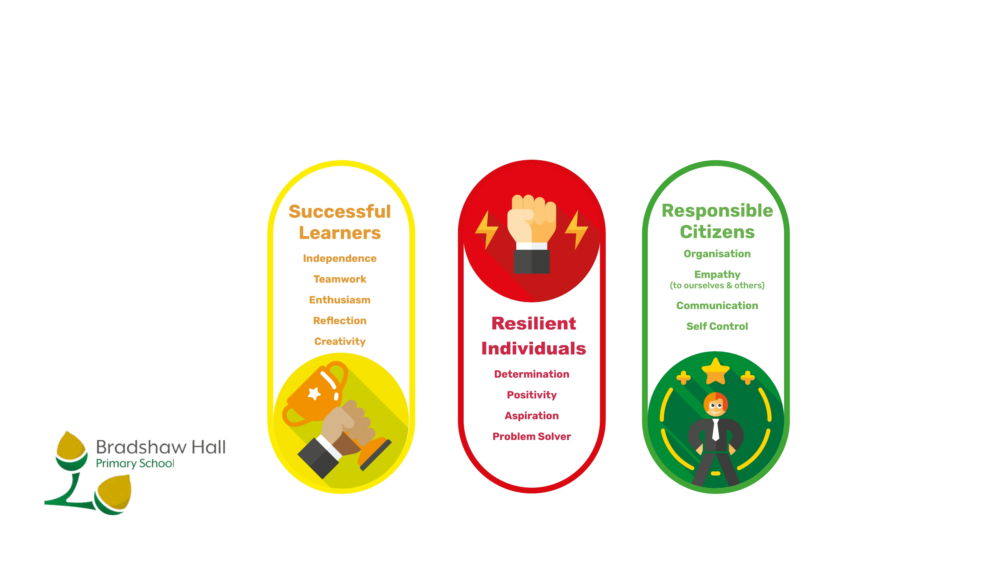
Bradshaw Hall School Values

Slide 6


Slide 7


Slide 8


Slide 9


Slide 10


Slide 11
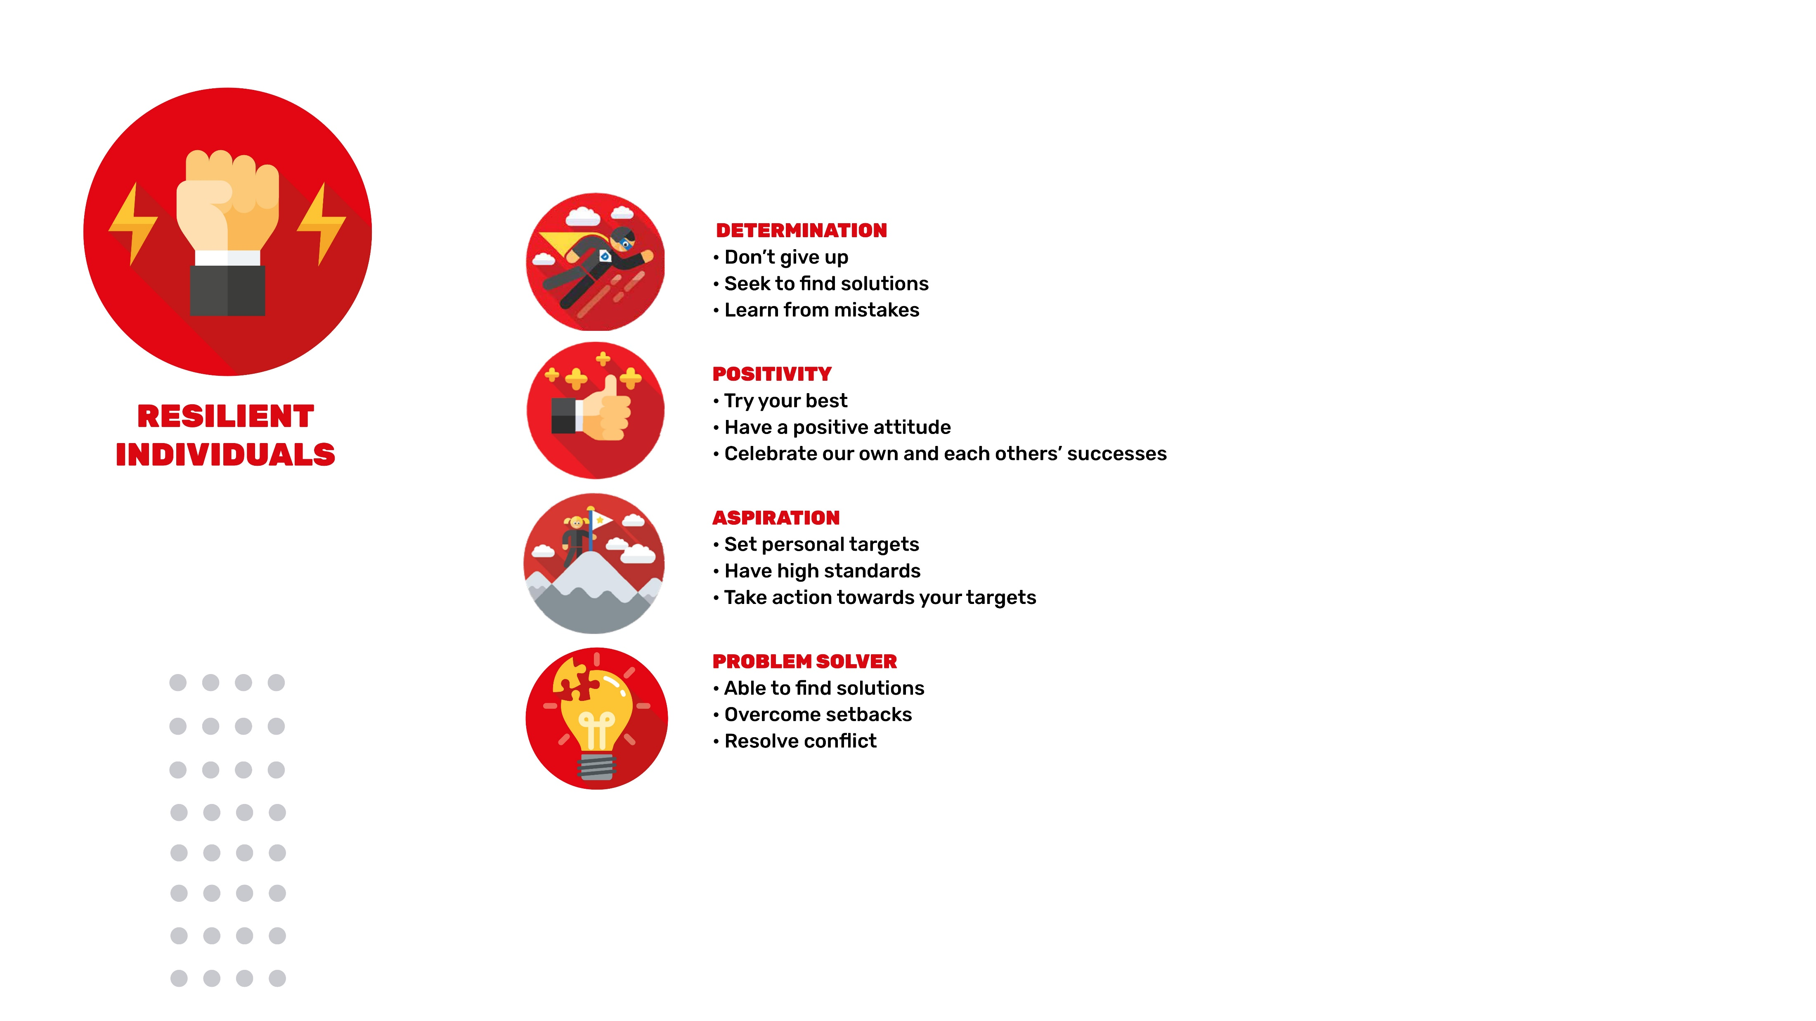

Slide 12


Slide 13



Slide 14


