Slide 1
Reading – One Voice
By Simon Downes and Amy Isbister

Slide 2
How is learning across school sequenced?
Nursery:
Early Reading
Teaching of Early Reading is across 4 key areas of the curriculum
Communication and Language
Literacy
Expressive Arts and Design
Understanding the World
Phase 1 Phonics and text in the environment.
In Music children link signs and symbols to actions
Stories within the curriculum and books available in provision
Print rich environment
Songs, poems and re-reading texts to develop C & L

Slide 3
How is learning across school sequenced?
Reception:
Reading in ELGs is split into Word Reading and Comprehension
Rocket Phonics Programme - DfE validated scheme.
Comprehension - story rich environment, Target Practice Readers, focus on vocabulary
Tales Toolkit resources - story structures and common themes

Slide 4
How is learning across school sequenced?
KS1:
Year 1
Rocket Phonics scheme delivers phonics to develop reading and spelling.
Whole class teaching where ever possible/appropriate with intervention/additional teaching time as identified through assessment
Daily lessons with two sounds per week and one common exception word session
Revisit and review in each lesson and recaps each half term.
Comprehension opportunities on blending days in Year 1.
Developing fluency through reading with adults and two reading lessons each week.
Use of Target Practice Readers to ensure exposure to newly taught sounds.
Transition into Year 2 and build towards Reading Discovery approach as phonics knowledge and fluency increase.

Slide 5
How is learning across school sequenced?
KS1:
Year 2
4 phonics lessons, focusing on recapping alternative sounds and introducing Y2 spelling patterns
Double page spread in phonics booklet with review, reading comprehension and sentence writing.
Target Practice Readers to give children opportunities to read other texts independently during phonics lessons
Autumn Reading lessons: 2 lessons focusing on specific skills based on a picture book and 2 fluency lessons using the Target Practice Readers
Spring/Summer Reading lessons: 4 lessons (1:vocabulary, 2:fluency, 3:introduce skill, 4:assess skill)
Reading Interventions: focus children for Reading 1:1, Precision Teach Read

Slide 6
How is learning across school sequenced?
KS2:
Children from Years 2 - 6 follow the school’s Reading Discovery model which is the primary vehicle for teaching comprehension skills.
Each term, each year group explores one key theme through a class novel, non-fiction texts, poetry and other text types such as song lyrics. Examples of the themes include 'Life and Death,' 'Friendships' and 'Climate Change.'
Each text or chapter is explored for 30 minutes 4 days a week and follows the structure below:
Day 1- Shared reading, recording and discussing initial thoughts and questions
Day 2- Vocabulary work
Day 3- Activity related to a particular VIPERS objective (vocabulary, infer, predict, explain, retrieve, summarise)
Day 4- VIPERS assessment questions
For Year 2 and Year 3, days 1 and 2 are merged to allow for an additional day based around fluency.
At the end of the term the theme is consolidated with a P4C (Philosophy 4 Children) debate.

Slide 7
It’s a fun way to explore reading and learn new things. You can think and question yourself.
Year 6
It helps us to learn reading skills for everyday life.
Year 4
It’s a good way to engage with the text and have fun reading.
Year 5

Slide 8
How are skills built upon through the school?
Fluency
By KS2, children are becoming fluent readers with a focus on prosody. Any children who either have not passed the phonics screening or who are struggling with fluency are identified as targeted readers who read regularly with an adult. They also have an additional Reading Discovery fluency lesson. Strategies such as echo reading and choral reading also support children’s fluency.
Comprehension
In KS2, children develop their comprehension skills in Reading Discovery sessions where questions related to the KS2 content domains are applied to more challenging texts.

Slide 9
Measuring Progress
In Reception and Year 1 the Rocket Phonics scheme has built in assessment opportunities each half-term. We carry out a baseline assessment in Autumn 1 and track progress. Children requiring intervention are identified in pupil progress meetings. In Year 1 we are currently trialling the PIRA reading assessments to track comprehension development. In Year 2 the Benchmarking kit is used to ensure children have appropriate comprehension before moving book bands.
At the end of Reception children are assessed against the reading ELGs and at the end of Year 2 children complete the statutory assessments.
In KS2:
End of the week Reading Discovery assessment related to an objective taken from the KS2 Content Domains
Termly standardised assessment

Slide 10
Challenge and Differentiation:
Challenge:
In EYFS and KS1, children are moved on to a new book band as soon as the sounds taught at that level are secure.
In KS2, children are challenged with high level texts and varied Recommended Reads.
SEND & EAL: Differentiation:
In KS1, we use the Rocket Phonics materials within interventions to ensure children are being stretched at the appropriate level. For children who are developing initial phonemic awareness we continue communication, speech and language programmes.
In Year 2 those children who did not pass the phonics screening are targeted for additional support.
We track the bottom 20% of readers’ fluency using the DIBELS fluency assessment every half term.
In KS2,
BR@P
Additional Reading Discovery fluency sessions
Bottom 20% identified as targeted readers- listened to at least twice per week
Support from school librarian
DIBELS fluency assessment

Slide 11
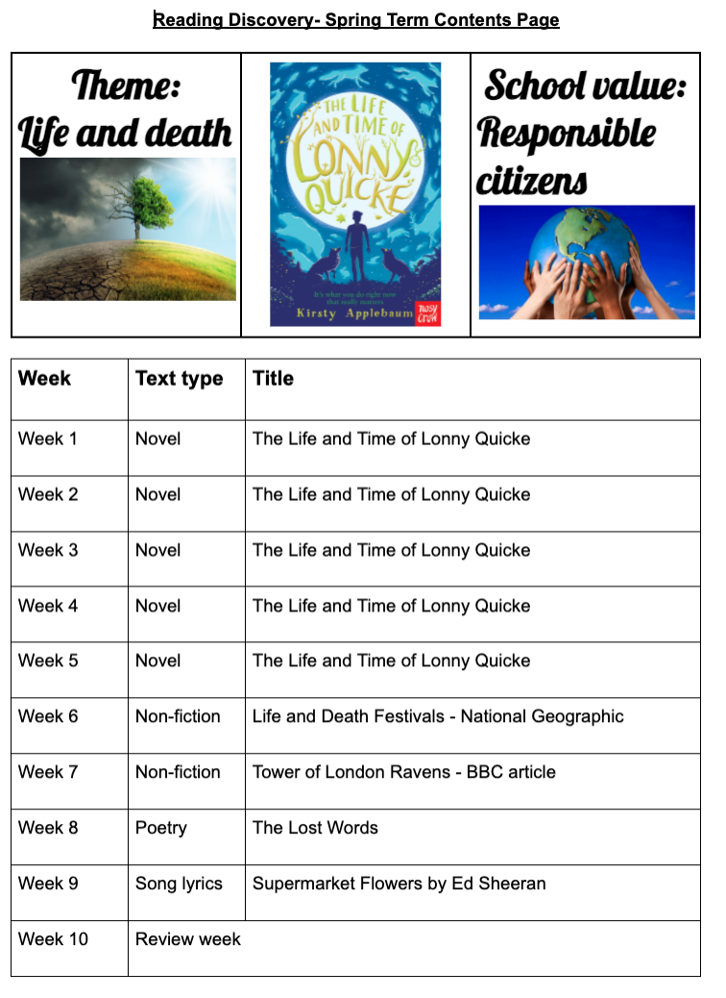
Children’s books and outcomes:
Reception and Y1
Focus on oral rather than written outcomes – more time spent reading, discussing and thinking.
Summer Term Y1 begin to record brief written responses to aid transition into Year 2 for children working at appropriate level.
Y2 - 6
Reading Discovery books:
Contents page showing theme, school value, overview of novel chapters, non-fiction texts, poetry and other text types
High expectations of presentation in line with other subjects
Feedback to support next steps

Slide 12
Strengths
A love of reading culture within school
A consistent approach to reading and comprehension through the Reading Discovery model (Y2-Y6)
An approved Systematic Synthetic Phonics Scheme
Well-resourced reading schemes, year group Recommended Reads, school library, Year 6 Reading Champions
Clear and consistent understanding of reading skills (VIPERS)
BR@P intervention and DIBELS fluency assessment
KS1 Parental workshops

Slide 13
Next steps
Further embed KS2 P4C to consolidate Reading Discovery themes
Support the transition in reading between Year 2 and Year 3

